Slide 1
01
Aggregate DAX Functions
SUM, AVERAGE, MAX, MIN, COUNTROWS, DISTINCTCOUNT, DIVIDE

Slide 2
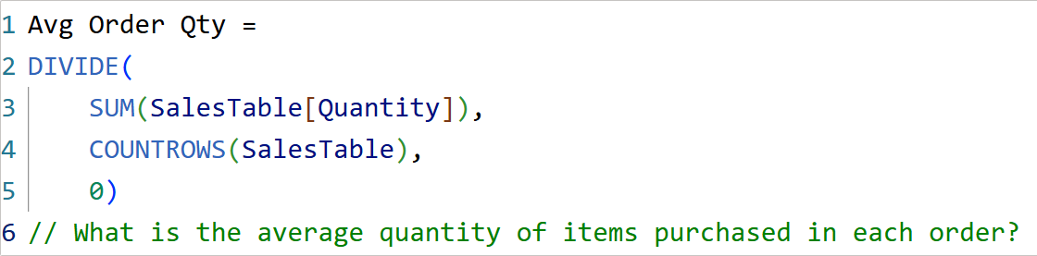
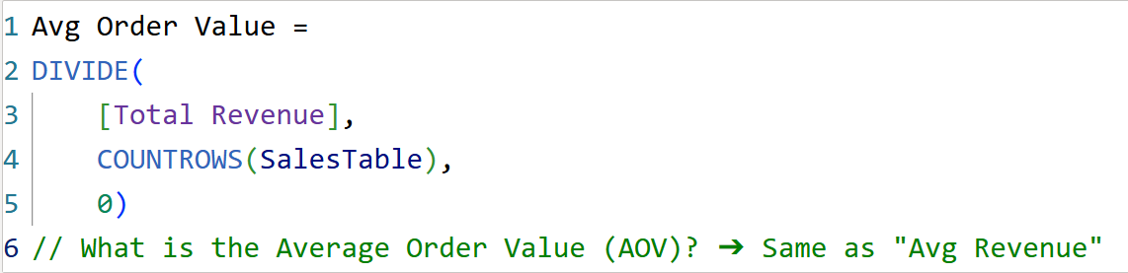
Q1
What is the average discount percentage across all sales transactions?
Q2
What is the average quantity of items purchased in each order?
Q3
What is the Average Order Value (AOV)?

Slide 3
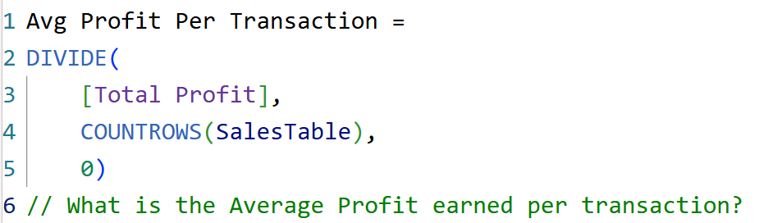
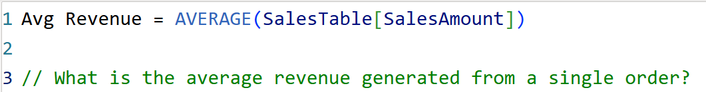
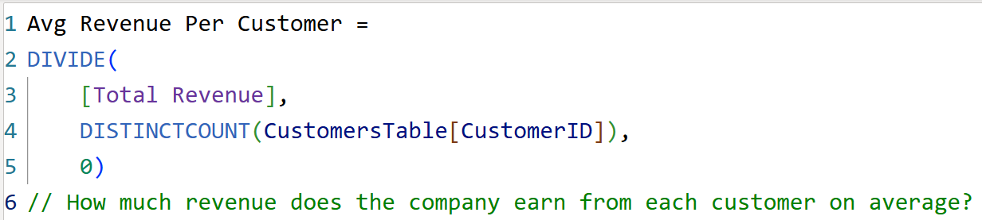
Q4
What is the Average Profit earned per transaction?
Q5
What is the average revenue generated from a single order?
Q6
How much revenue does the company earn from each customer on average?

Slide 4
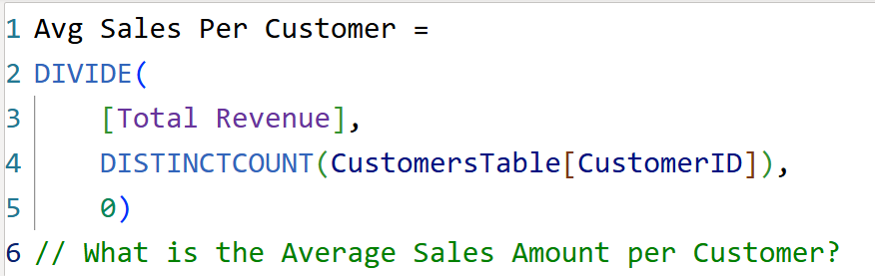
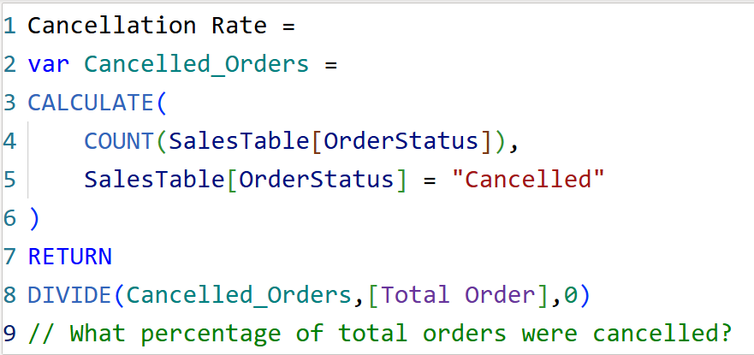
Q7
What is the Average Sales Amount per Customer?
Q8
What percentage of total orders were cancelled?

Slide 5
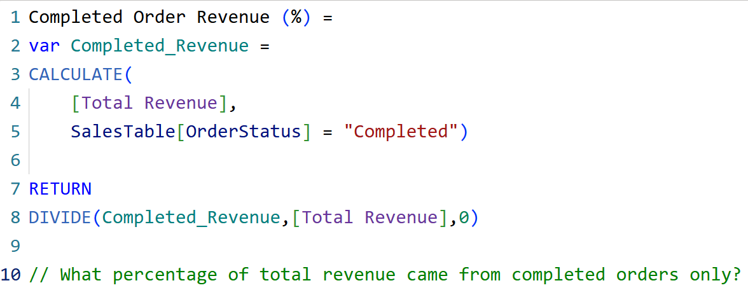
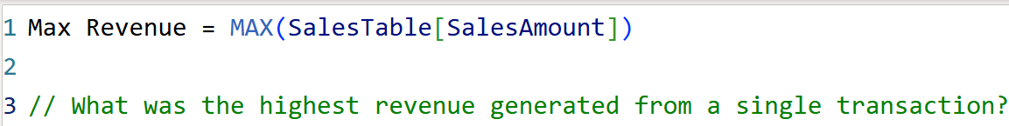
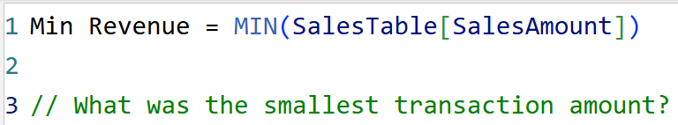
Q9
What percentage of total revenue came from completed orders only?
Q10
What was the highest revenue generated from a single transaction?
Q11
What was the smallest transaction amount?

Slide 6
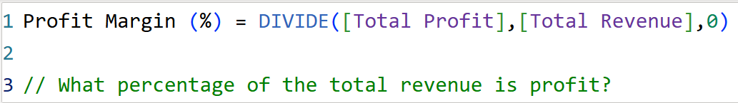
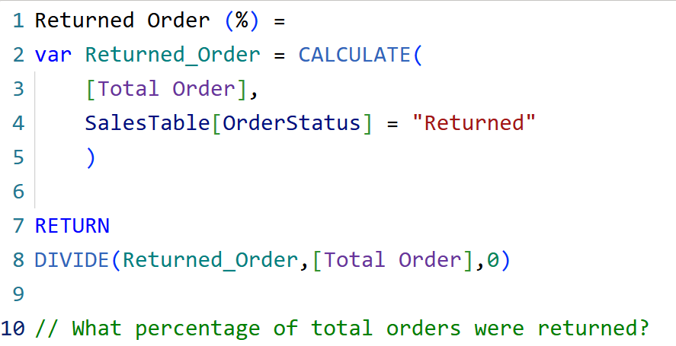
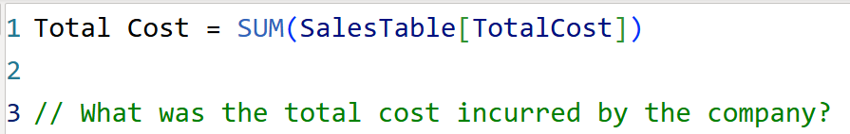
Q12
What percentage of the total revenue is profit?
Q13
What percentage of total orders were returned?
Q14
What was the total cost incurred by the company?

Slide 7
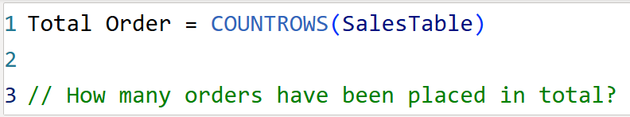
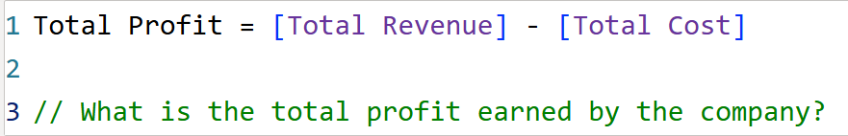
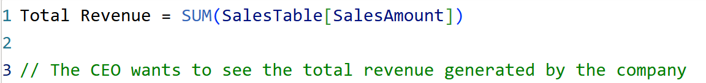
Q15
How many orders have been placed in total?
Q16
What is the total profit earned by the company?
Q17
The CEO wants to see the total revenue generated by the company.

Slide 8
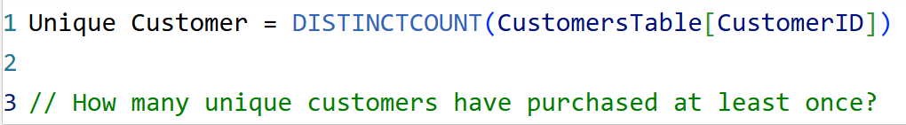
Q18
How many unique customers have purchased at least once?

Slide 9
02
Filter Context DAX
CALCULATE, FILTER, ALL, OR / NOT conditions

Slide 10
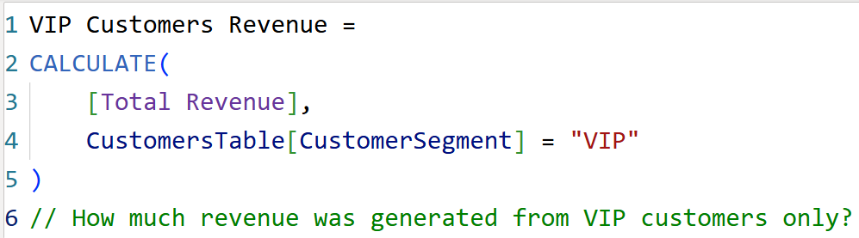
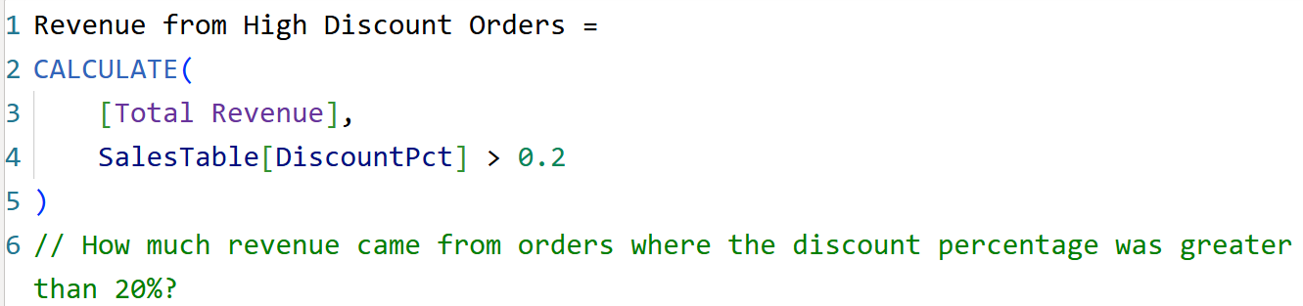
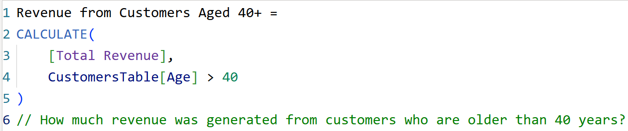
Q19
How much revenue was generated from VIP customers only?
Q20
How much revenue came from orders where the discount percentage was greater than 20%?
Q21
How much revenue was generated from customers who are older than 40 years?

Slide 11
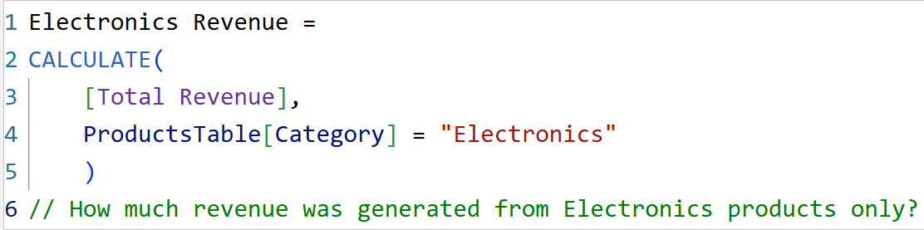
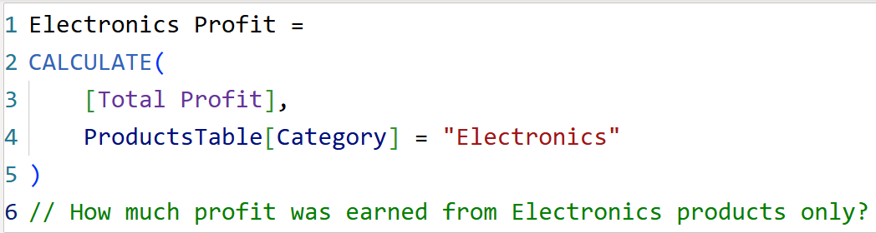
Q22
How much revenue was generated from Electronics products only?
Q23
How much profit was earned from Electronics products only?

Slide 12
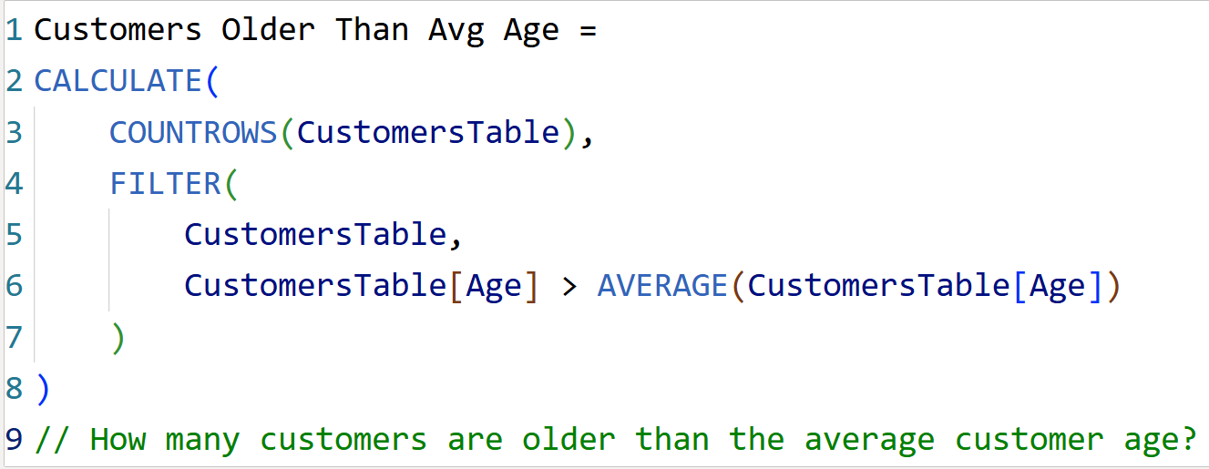
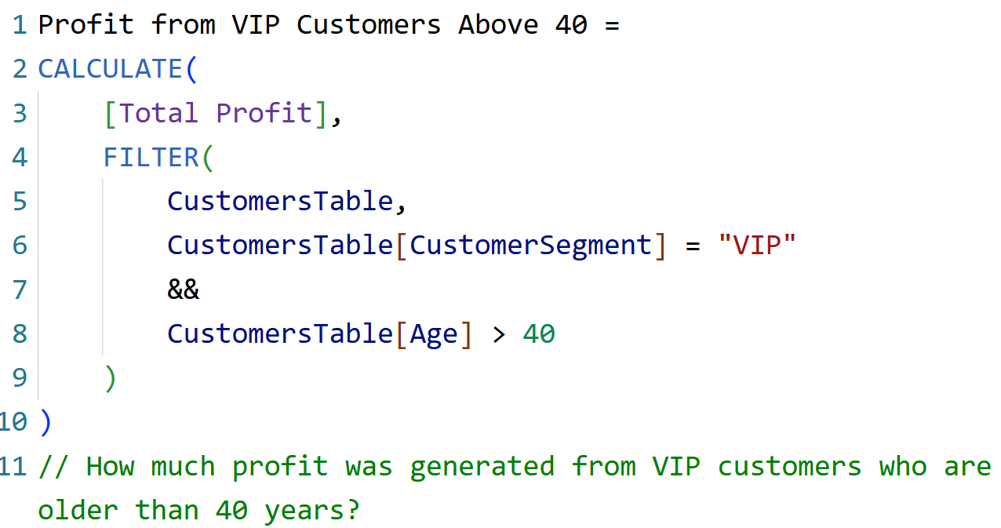
Q24
How many customers are older than the average customer age?
Q25
How much profit was generated from VIP customers who are older than 40 years?

Slide 13
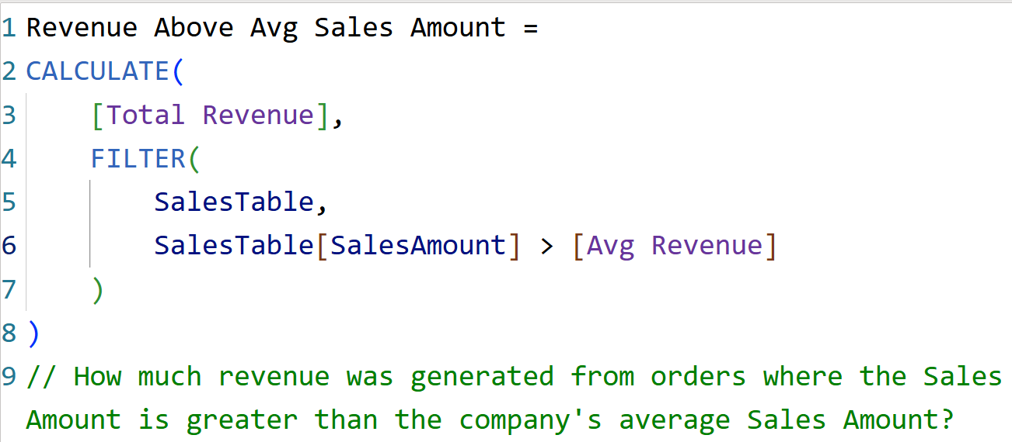
Q26
How much revenue was generated from orders where the Sales Amount is greater than the company's average Sales Amount?

Slide 14
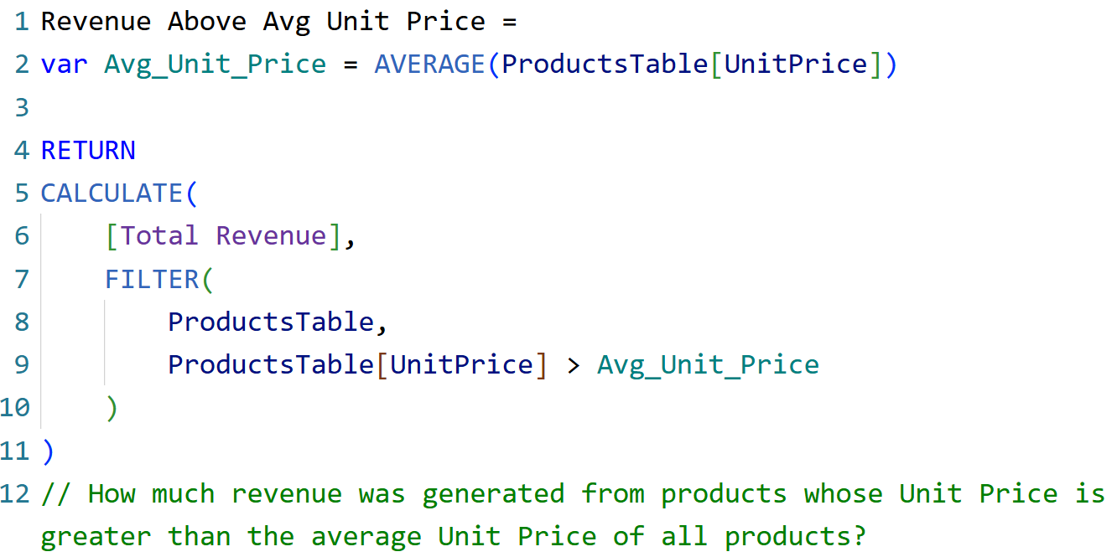
Q27
How much revenue was generated from products whose Unit Price is greater than the average Unit Price of all products?

Slide 15
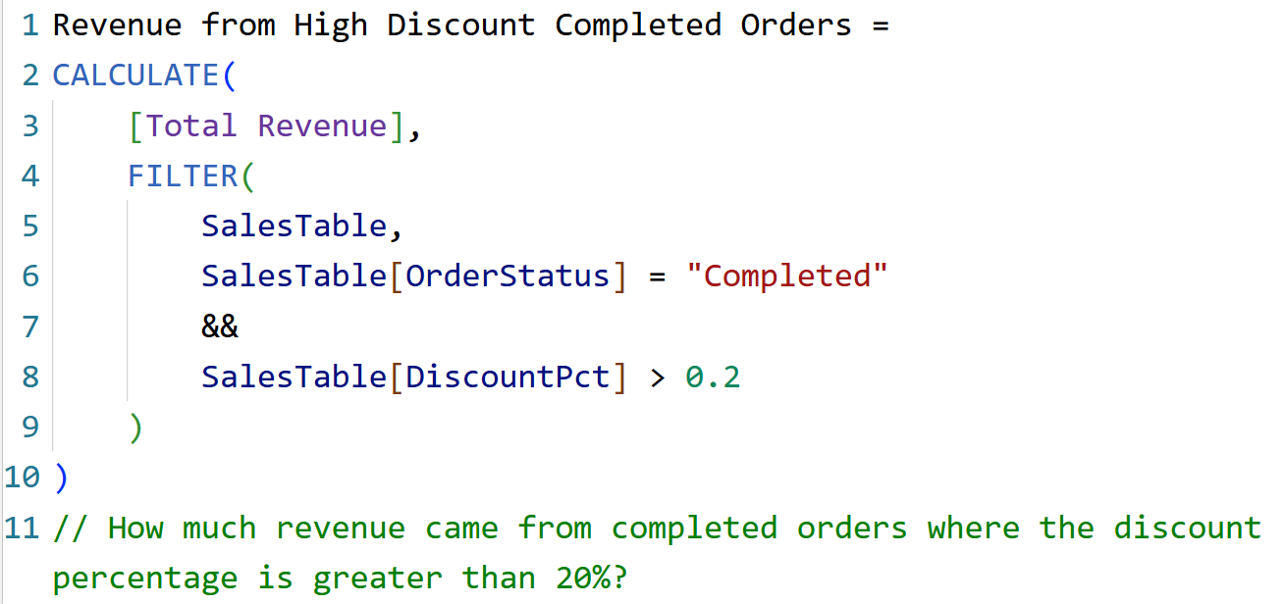
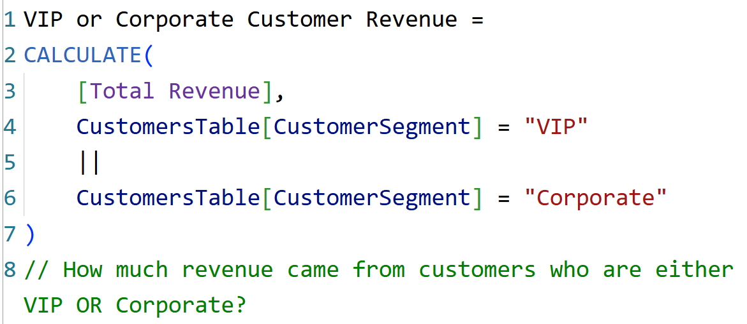
Q28
How much revenue came from completed orders where the discount percentage is greater than 20%?
Q29
How much revenue came from customers who are either VIP OR Corporate?

Slide 16
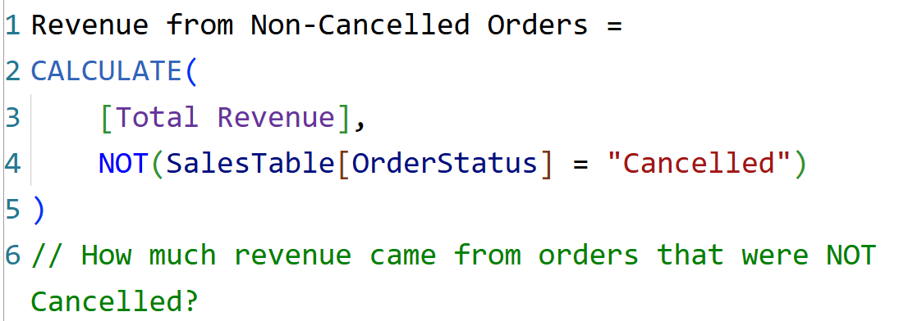
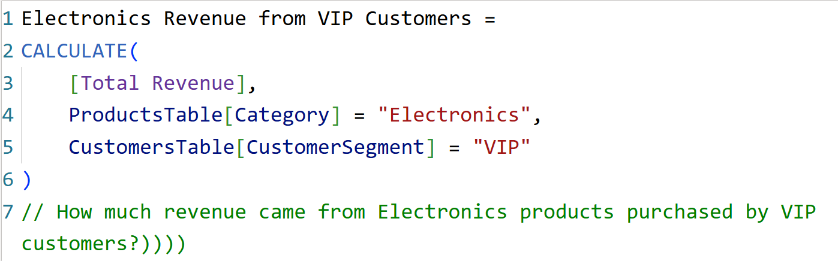
Q30
How much revenue came from orders that were NOT Cancelled?
Q31
How much revenue came from Electronics products purchased by VIP customers?

Slide 17
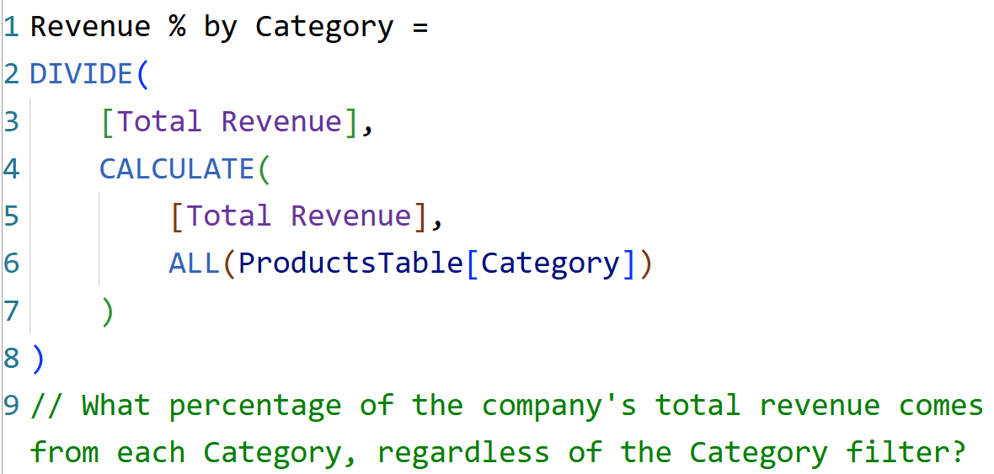
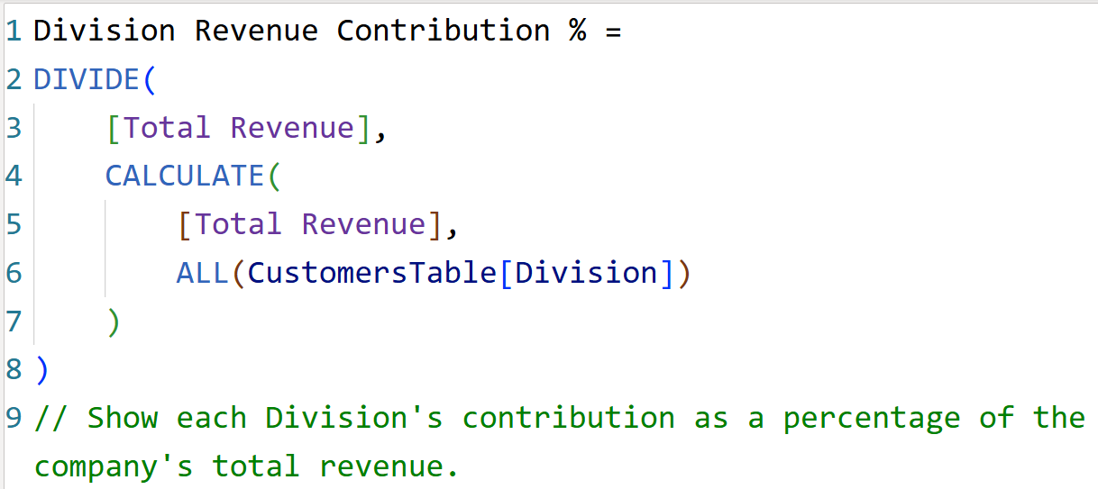
Q32
What percentage of the company's total revenue comes from each Category, regardless of the Category filter?
Q33
Show each Division's contribution as a percentage of the company's total revenue.

Slide 18
03
Conditional Logic DAX
IF and SWITCH functions

Slide 19
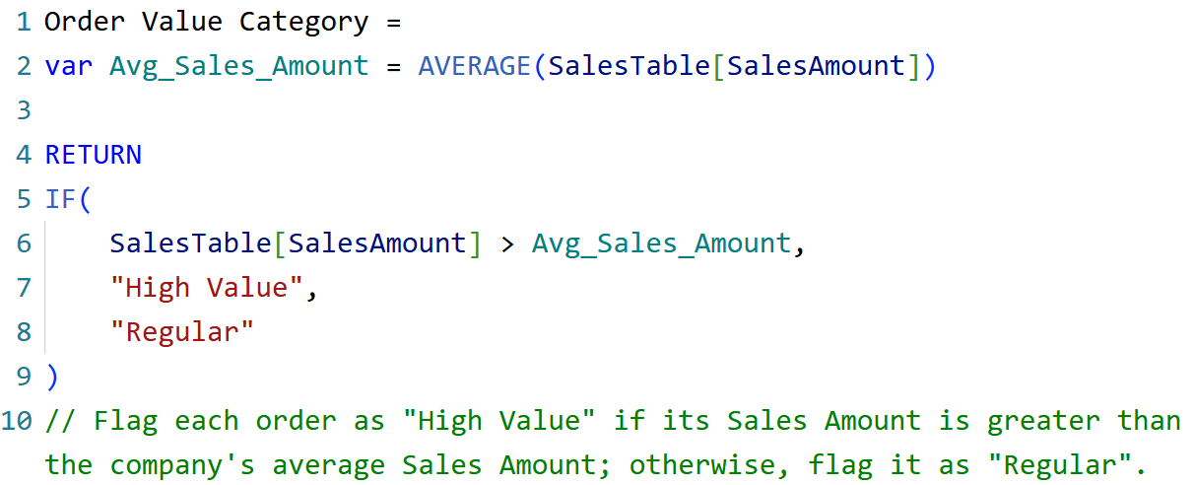
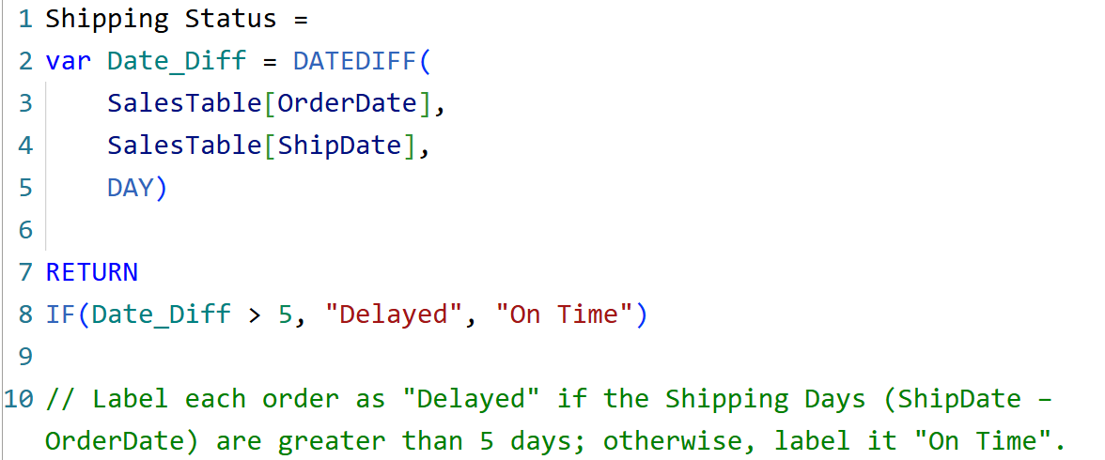
Q34
Flag each order as "High Value" if its Sales Amount is greater than the company's average Sales Amount; otherwise, flag it as "Regular".
Q35
Label each order as "Delayed" if the Shipping Days (ShipDate - OrderDate) are greater than 5 days; otherwise, label it "On Time".

Slide 20
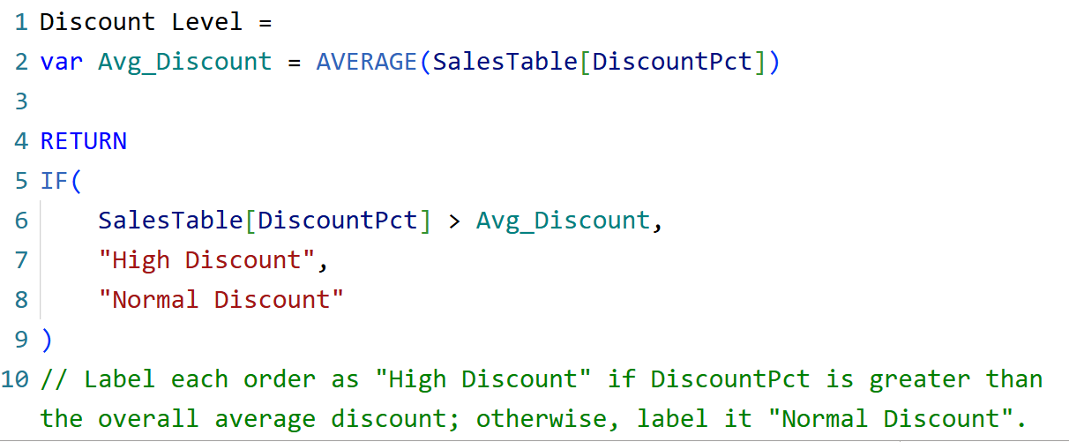
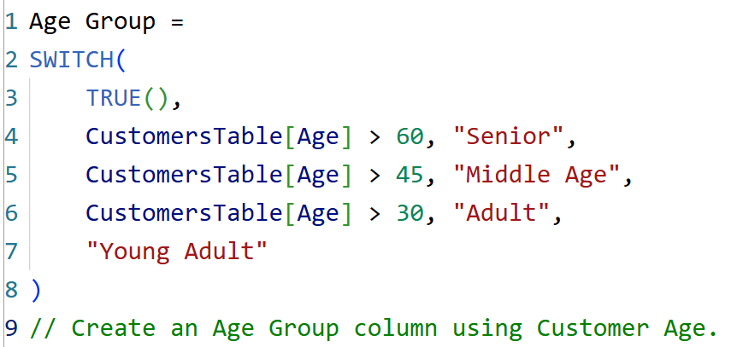
Q36
Label each order as "High Discount" if DiscountPct is greater than the overall average discount; otherwise, label it "Normal Discount".
Q37
Create an Age Group column using Customer Age.

Slide 21
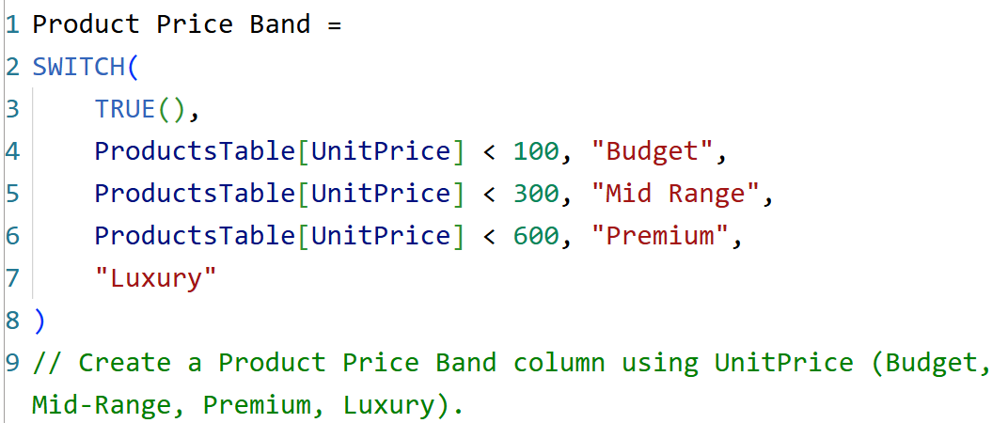
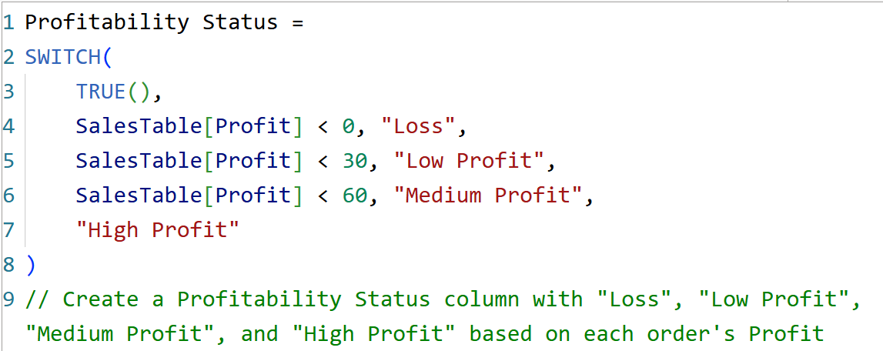
Q38
Create a Product Price Band column using UnitPrice (Budget, Mid-Range, Premium, Luxury).
Q39
Create a Profitability Status column with "Loss", "Low Profit", "Medium Profit", and "High Profit" based on each order's Profit.

Slide 22
04
Iterator DAX Functions
AVERAGEX, MAXX, MINX, COUNTX

Slide 23
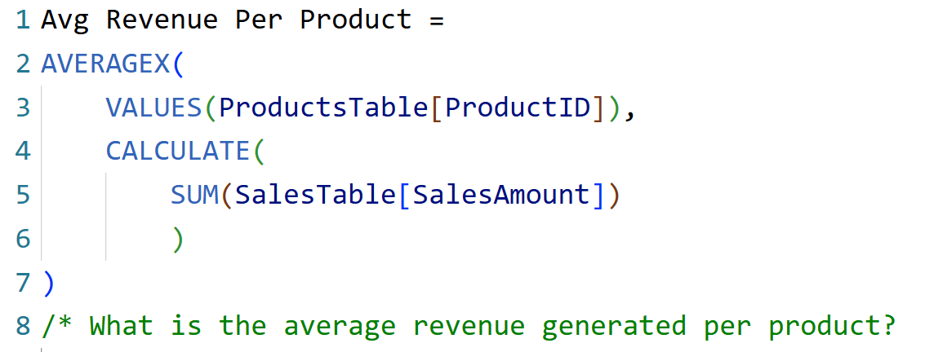
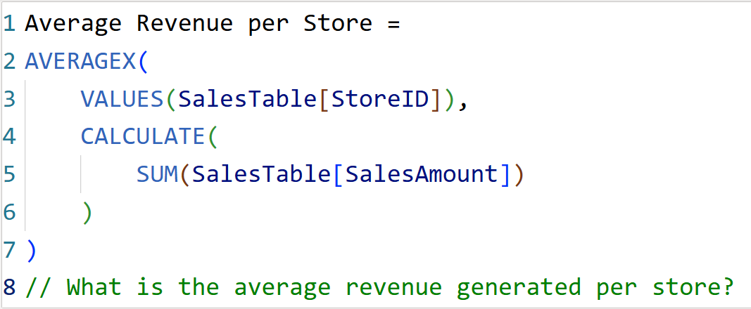
Q40
What is the average revenue generated per product?
Q41
What is the average revenue generated per store?

Slide 24
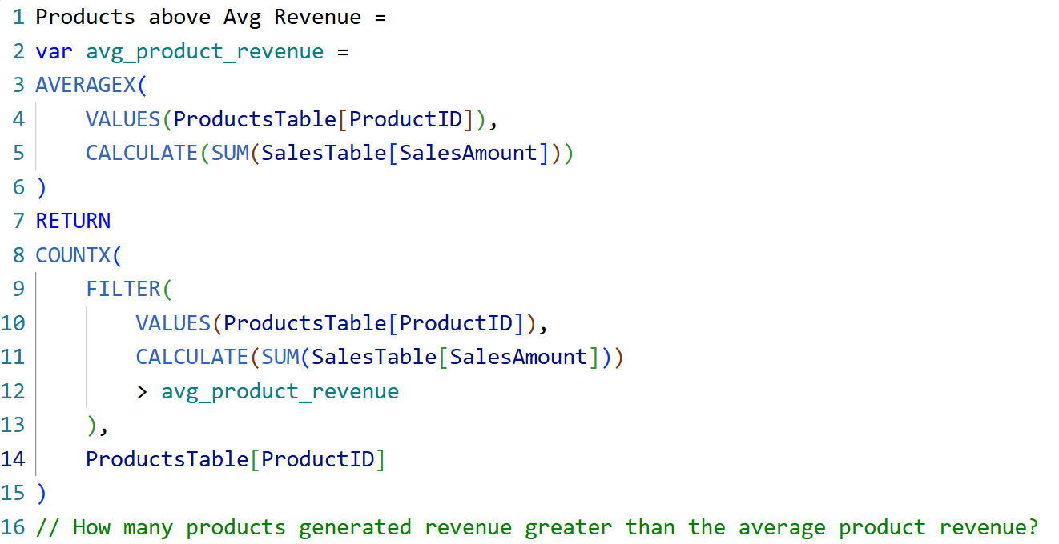
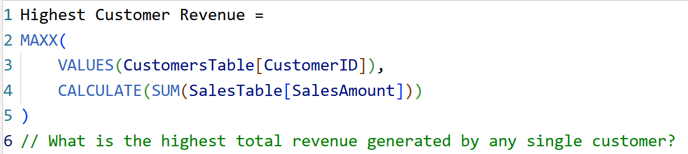
Q42
How many products generated revenue greater than the average product revenue?
Q43
What is the highest total revenue generated by any single customer?

Slide 25
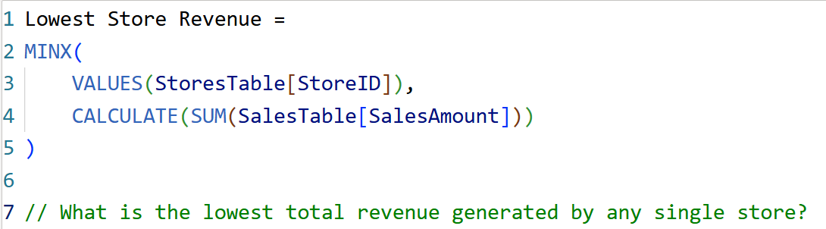
Q44
What is the lowest total revenue generated by any single store?

Slide 26
05
Time Intelligence DAX
YTD, QTD, MTD, PY, DATEADD, Growth (%)

Slide 27
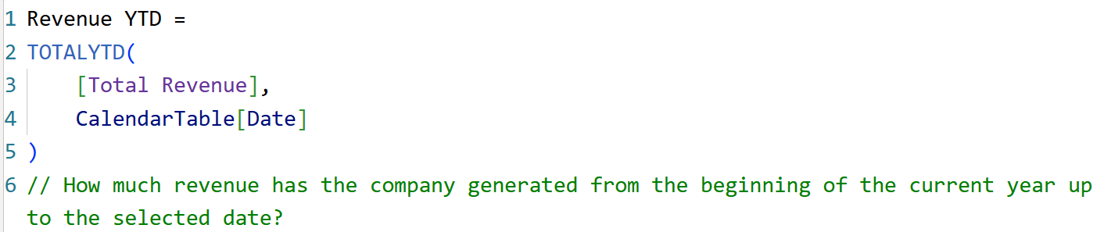
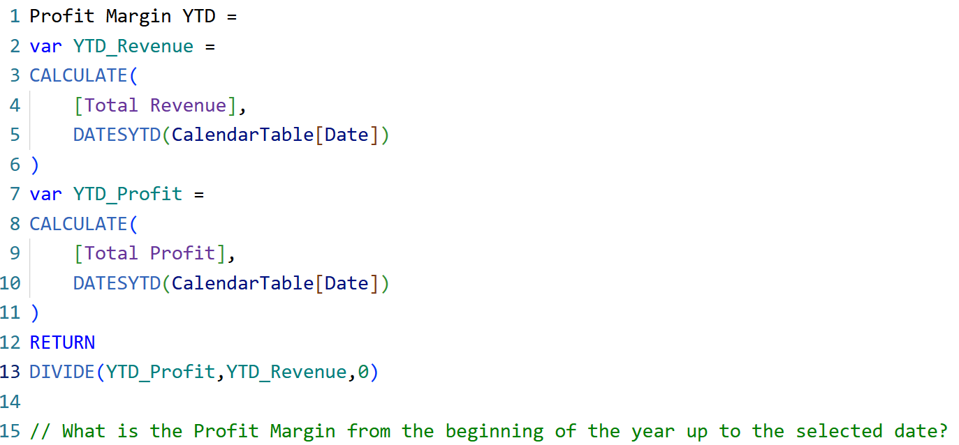
Q45
How much revenue has the company generated from the beginning of the current year up to the selected date?
Q46
What is the Profit Margin from the beginning of the year up to the selected date?

Slide 28
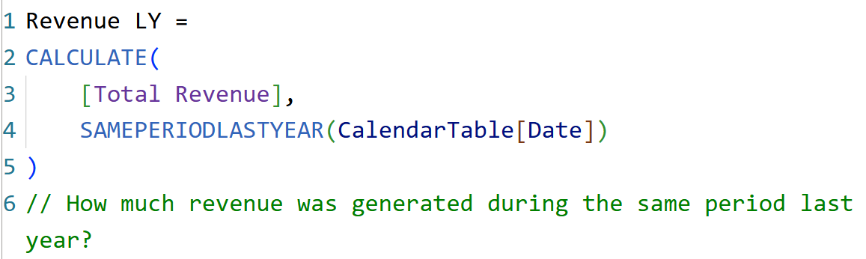
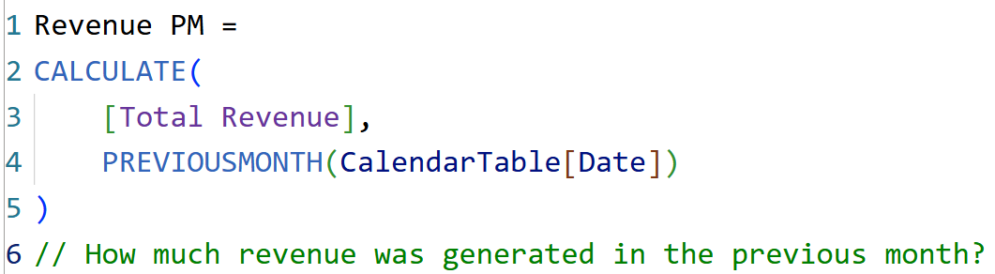
Q47
How much revenue was generated during the same period last year?
Q48
How much revenue was generated in the previous month?

Slide 29
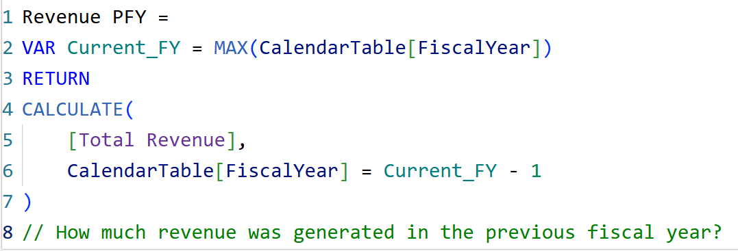
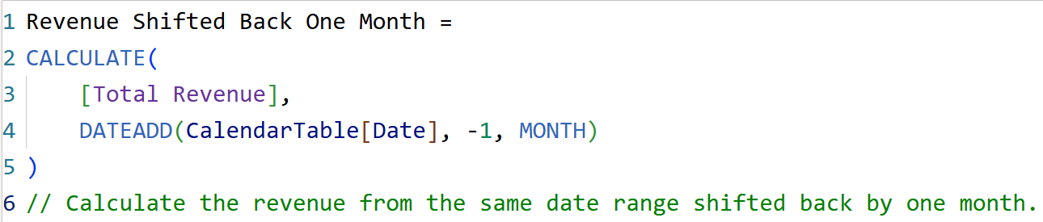
Q49
How much revenue was generated in the previous fiscal year?
Q50
Calculate the revenue from the same date range shifted back by one month.

Slide 30
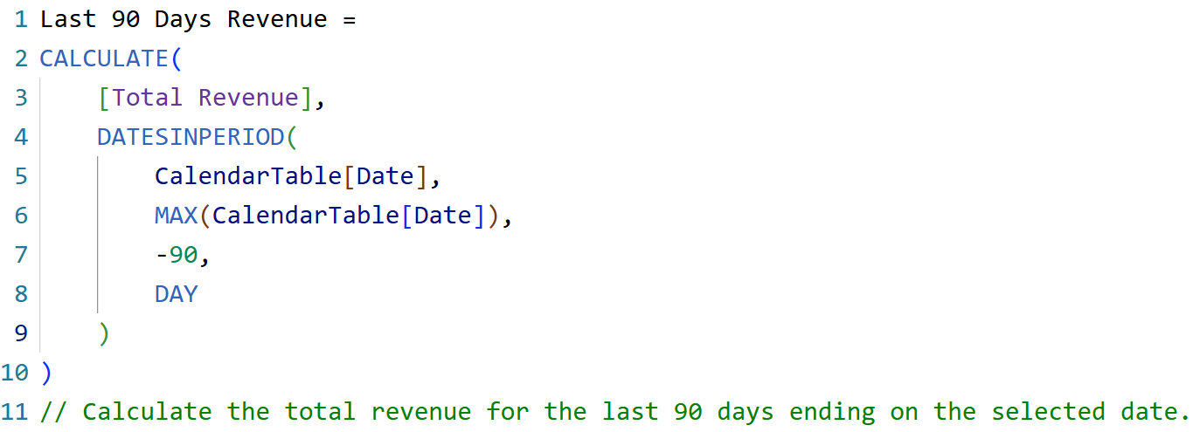

Q51
Calculate the total revenue for the last 90 days ending on the selected date.
Q52
Calculate the total profit generated during the last 6 months ending on the selected date.

Slide 31


Q53
Calculate the total quantity sold during the last 30 days.
Q54
Calculate the total revenue generated during the last 12 months.

Slide 32


Q55
How much revenue has the company generated from the beginning of the current month up to the selected date?
Q56
Calculate the Month-to-Date (MTD) Profit.

Slide 33



Q57
How much revenue has the company generated from the beginning of the current quarter up to the selected date?
Q58
Calculate the Quarter-to-Date (QTD) Quantity Sold.
Q59
Calculate the total profit generated since the beginning of the current year.

Slide 34


Q60
What is the company's Profit Margin (%) from the beginning of the current year up to the selected date?
Q61
How many days did it take to ship each order from the Order Date to the Ship Date?

Slide 35



Q62
How many orders took more than 5 days to ship?
Q63
Create a calculated column that returns the month-end date for each Order Date.
Q64
Calculate the average number of days between Order Date and Ship Date.

Slide 36

Q65
What is the Month-over-Month (MoM) Revenue Growth (%) compared to the previous month?

Slide 37

Q66
Calculate the Month-over-Month (MoM) Profit Growth (%).

Slide 38

Q67
Calculate the Quarter-over-Quarter (QoQ) Revenue Growth (%).

Slide 39

Q68
Calculate the Year-over-Year (YoY) Revenue Growth (%).

Slide 40

Q69
Calculate the Year-over-Year (YoY) Profit Growth (%).

Slide 41

Q70
Compare the current MTD Revenue against the MTD Revenue from the same period last year.

Slide 42

Q71
Compare QTD Profit against the same period last year.

Slide 43

Q72
Calculate the YTD Revenue Growth (%) compared with the same period last year.

